Slide 1
Title – Profit Prediction
By
Pranit Pisal

Slide 2

Objective
To predict the Profits of upcoming Start-ups.

Slide 3

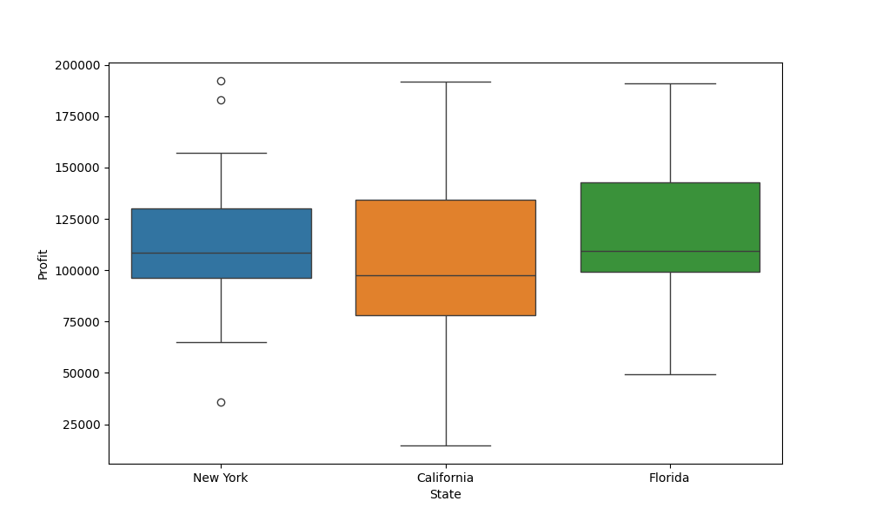
Solution
Doing EDA on current dataset.
Using Linear regression over the current data.
Analysing the insights and Graph patterns.

Slide 4


Business Impact
The solution provides help in assigning the predicted Profit to new Start-ups based on their R&D Spent, Administration, Marketing Spent and State.

